Slide 1
When you lack Vitamin C
Scurvy

Slide 2
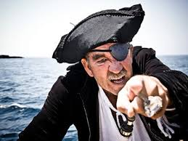
Pirates and sailors often did not have fruit such as oranges or limes which provide vitamin C so Scurvy was a very real disease that they would get.

Slide 3
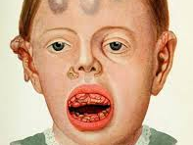
Scurvy
S

Slide 4
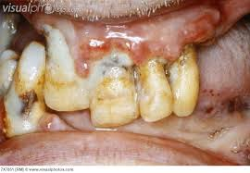

Slide 5
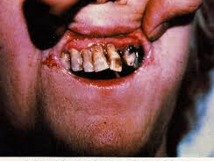

Slide 6
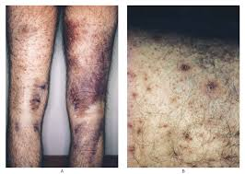

Slide 7
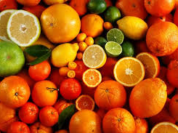
The Answer for Scurvy
Vitamin C

Slide 8
Spiritual Scurvy
Amos 8:11
11 Behold, the days come, saith the Lord GOD, that I will send a famine in the land, not a famine of bread, nor a thirst for water, but of hearing the words of the LORD:
KJV

Slide 9
Spiritual Scurvy

Slide 10
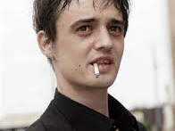
SMOKING

Slide 11
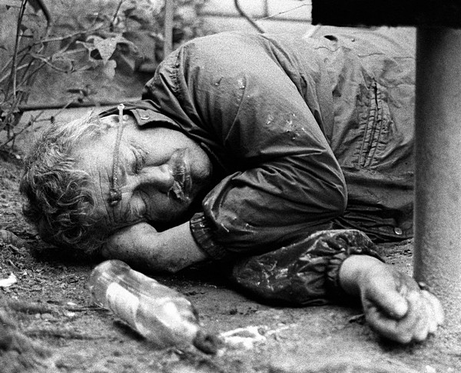
Alcoholism

Slide 12
UNGODLY DRESS

Slide 13
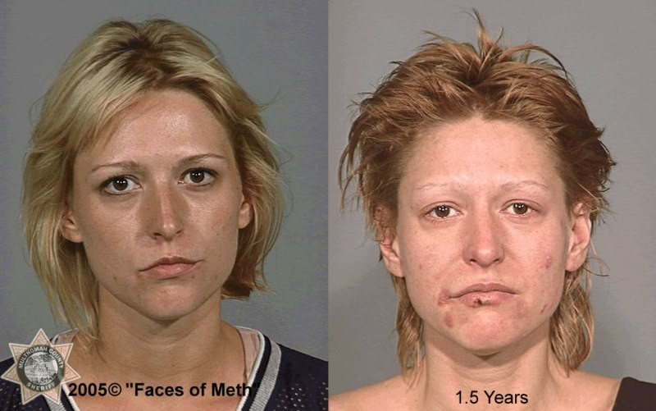
Drug addiction!

Slide 14
SPIRITUAL SCURVY
TO PREVENT, JUST OBEY
THE WORD OF GOD

